Slide 1
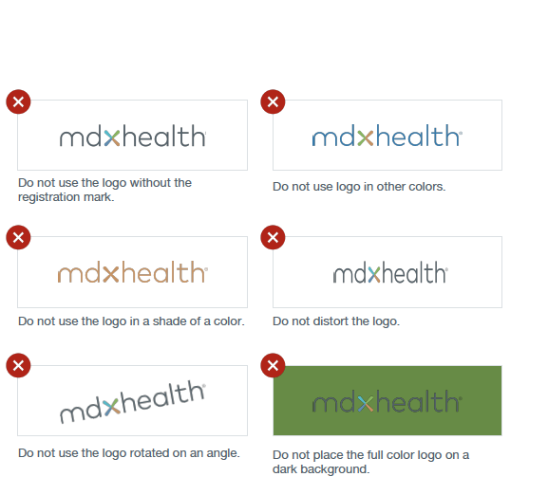
Brand Guidelines
Logo Don’ts
Consistency is vital when it comes to brand recognition. The mdxhealth and test logos should not be changed in any way, shape, or for. See examples to the right for additional scenarios to avoid.
Please note, this applies to all test logos as well.

Slide 2
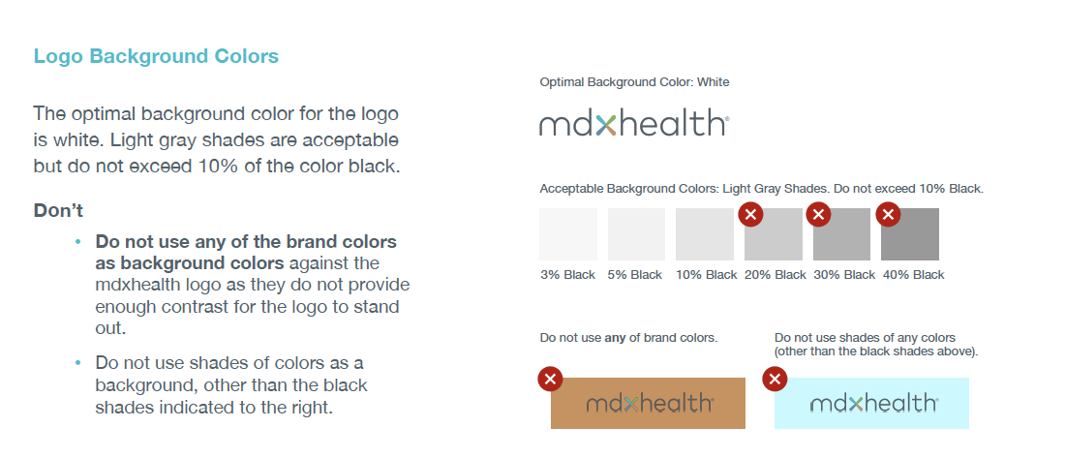
Brand Guidelines

Slide 3
Correct Logo Spelling
Please make sure to use the correct spelling and capitalization when referencing our company name and products.
Correct names:
mdxhealth
Mdxhealth (beginning of a sentence)
Confirm mdx
Resolve mdx
GPS mdx
Exo mdx

Slide 4


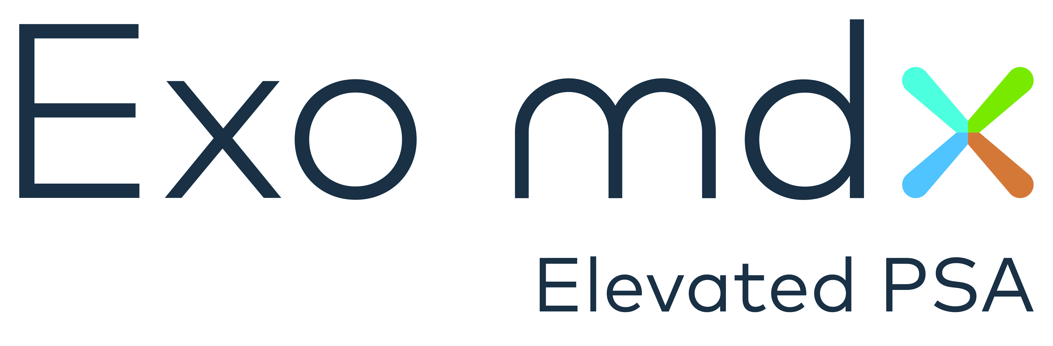

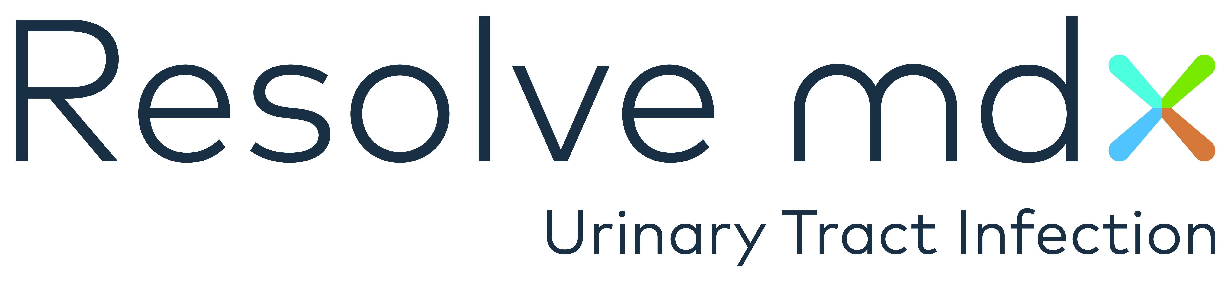
Logos

Slide 5
Title Slide

